Slide 1
CSE 332
Computer Organization and Architecture
Lecture 7: Memory (cache)
Tanzilur Rahman (Tnr)
Assistant Professor
North South University

Slide 2
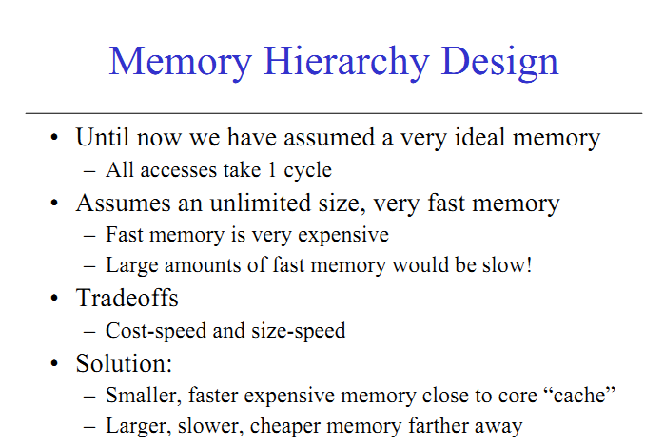

Slide 3
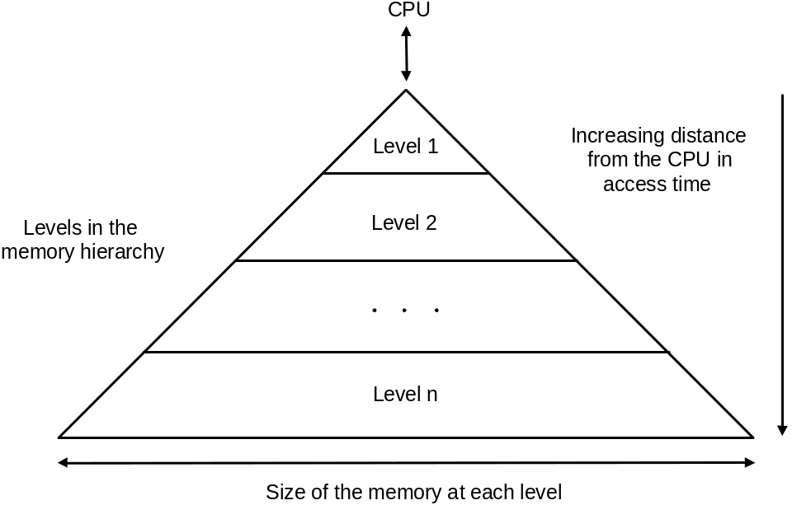
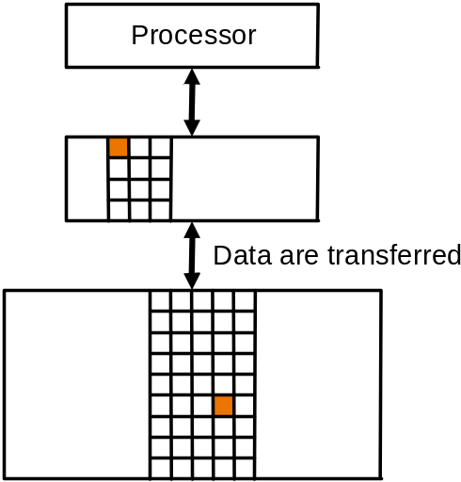
Memory Hierarchy
Users want large and fast memories…
  expensive and they don’t like to pay…
Make it seem like they have what they want…
  memory hierarchy
  hierarchy is inclusive, every level is subset of lower level
  performance depends on hit rates
Block of data
(unit of data copy)

Slide 4
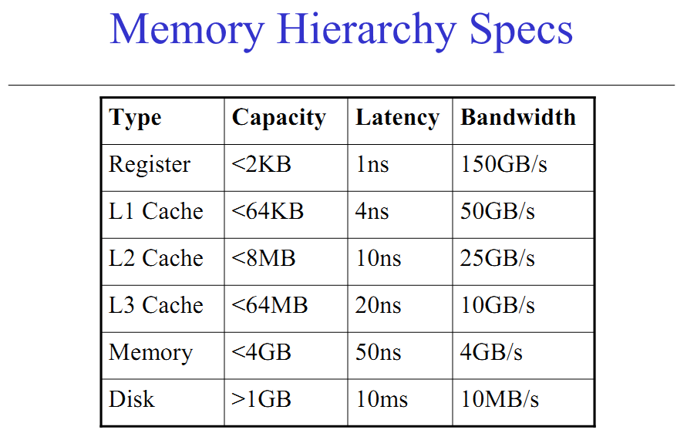

Slide 5
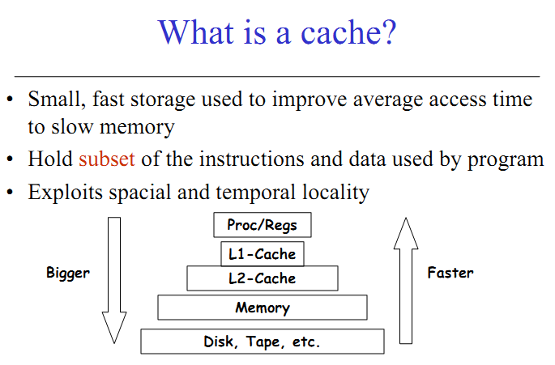

Slide 6
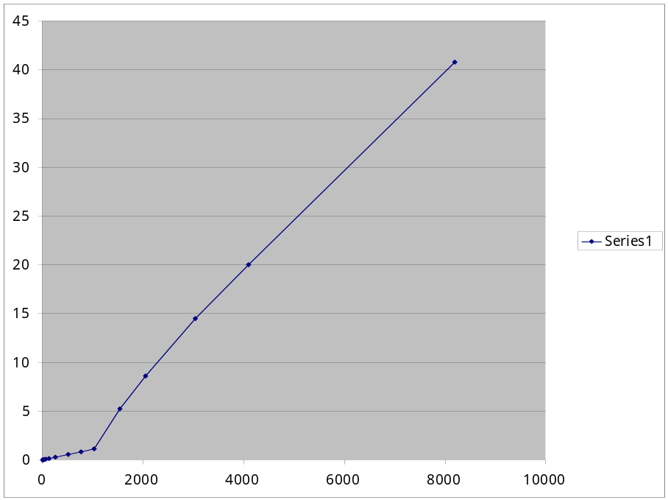
How will execution time grow with SIZE?
int array[SIZE];
int sum = 0;
for (int i = 0 ; i < 200000 ; ++ i) {
for (int j = 0 ; j < SIZE ; ++ j) {
sum += array[j];
}
}
TIME
?
SIZE
array fits in cache

Slide 7
Locality
Locality is a principle that makes having a memory hierarchy a good idea
If an item is referenced then because of
  temporal locality: it will tend to be again referenced soon
  spatial locality: nearby items will tend to be referenced soon
  why does code have locality – consider instruction and data?

Slide 8
Locality in data
Temporal: programs often access same variables, especially within loops
Ideally, commonly-accessed variables will be in registers
  but there are a limited number of registers
  in some situations, data must be kept in memory (e.g., sharing between threads)
Spatial: when reading location i from main memory, a copy of that data is placed in the cache but also copy i+1, i+2, …
  useful for arrays, records, multiple local variables
sum = 0;
for (i = 0; i < MAX; i++)
sum = sum + f(i);

Slide 9
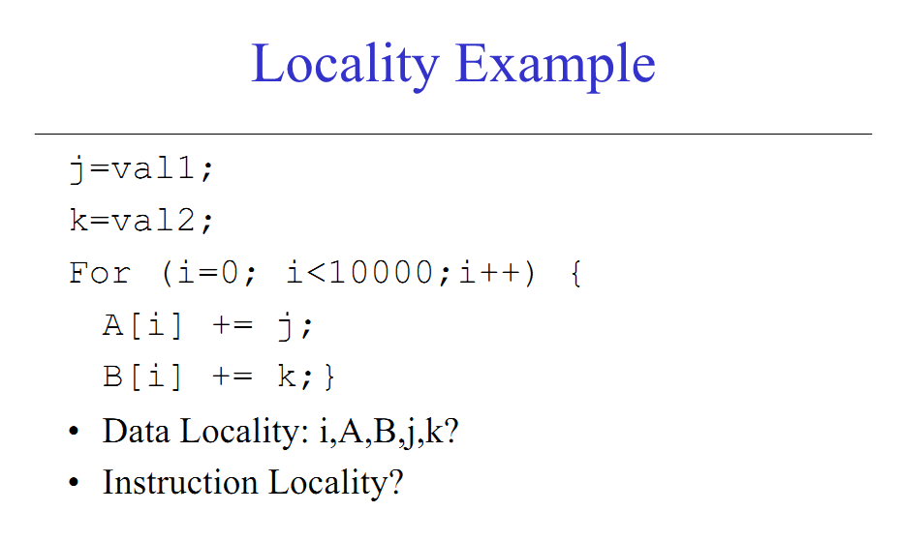
Locality

Slide 10
Memory System Performance
Memory system performance depends on three important questions:
  How long does it take to send data from the cache to the CPU?
  How long does it take to copy data from memory into the cache?
  How often do we have to access main memory?
There are names for all of these variables:
  The hit time is how long it takes data to be sent from the cache to the processor. This is usually fast, on the order of 1-3 clock cycles.
  The miss penalty is the time to copy data from main memory to the cache. This often requires dozens of clock cycles (at least).
  The miss rate is the percentage of misses.
CPU
A little static
RAM (cache)
Lots of
dynamic RAM

Slide 11
Terminology:
  block: minimum unit of data to move between levels
  hit: data requested is in upper level
  miss: data requested is not in upper level
  hit rate: fraction of memory accesses that are hits (i.e., found at upper level)
  miss rate: fraction of memory accesses that are not hits
    miss rate = 1 – hit rate
  hit time: time to determine if the access is indeed a hit + time to access and deliver the data from the upper level to the CPU
  miss penalty: time to determine if the access is a miss + time to replace block at upper level with corresponding block at lower level + time to deliver the block to the CPU

Slide 12
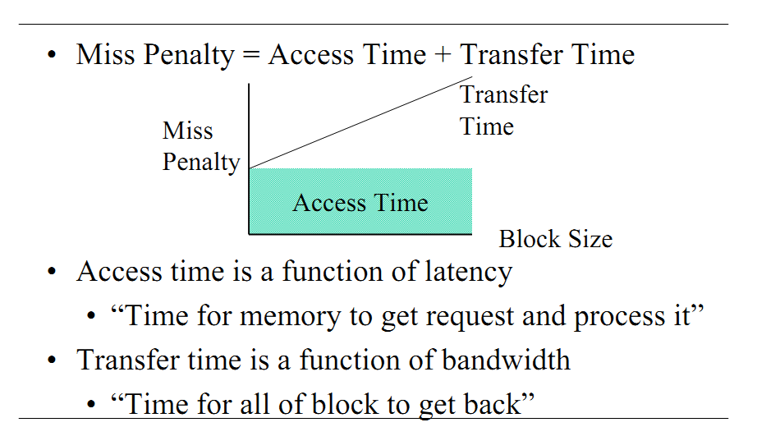
Miss hit

Slide 13
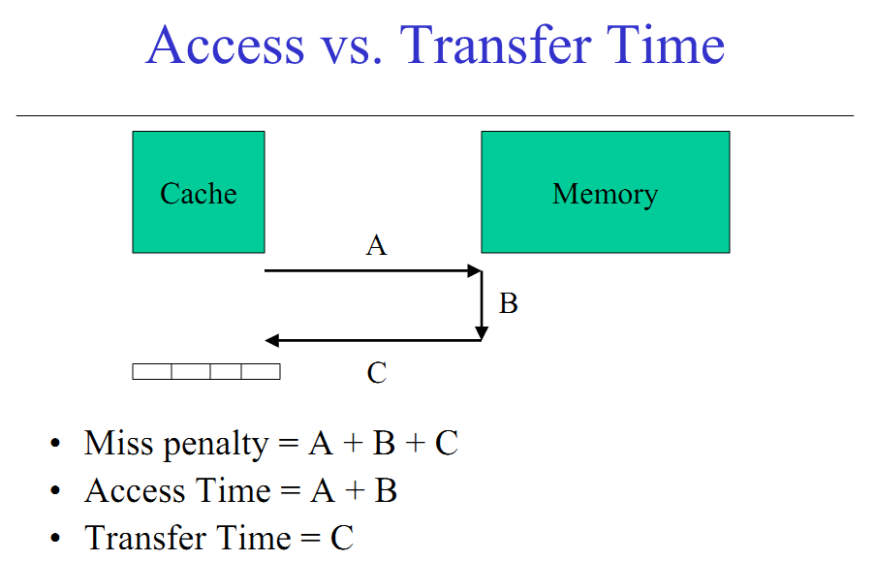
Miss hit

Slide 14
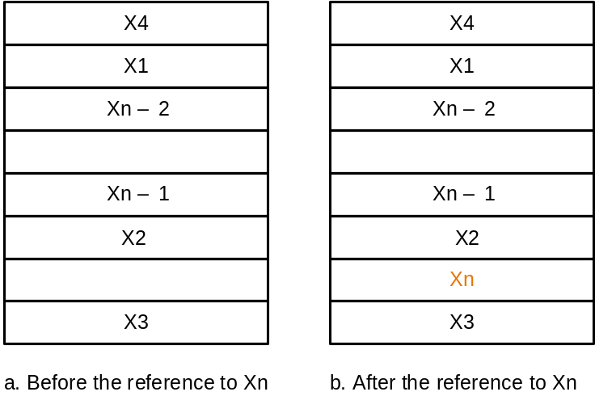
Caches
By simple example
Most Basic Issues:
  how do we know if a data item is in the cache?
  if it is, how do we find it?
  if not, what do we do?
  When fetching a block into full cache, how do we decide which other block gets kicked out?
Solution depends on cache addressing scheme…
Reference to X_{n}
causes miss so
it is fetched from
memory

Slide 15
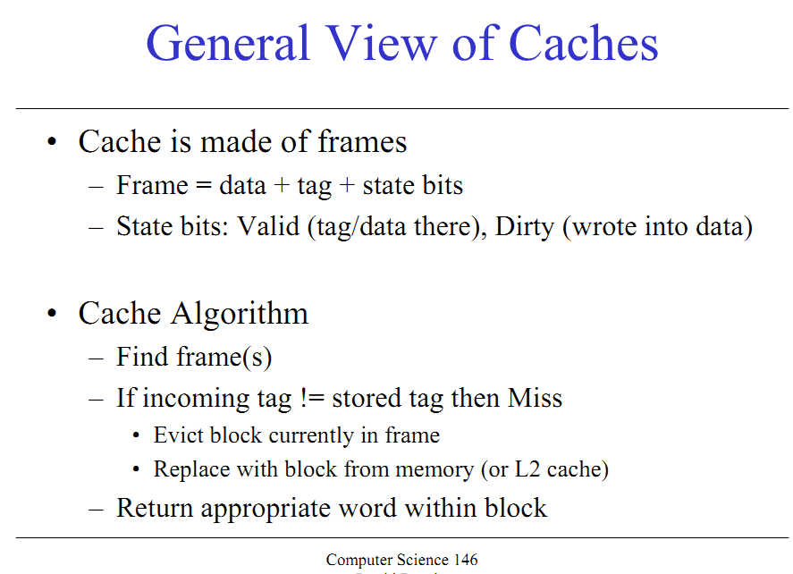
Caching Basics

Slide 16
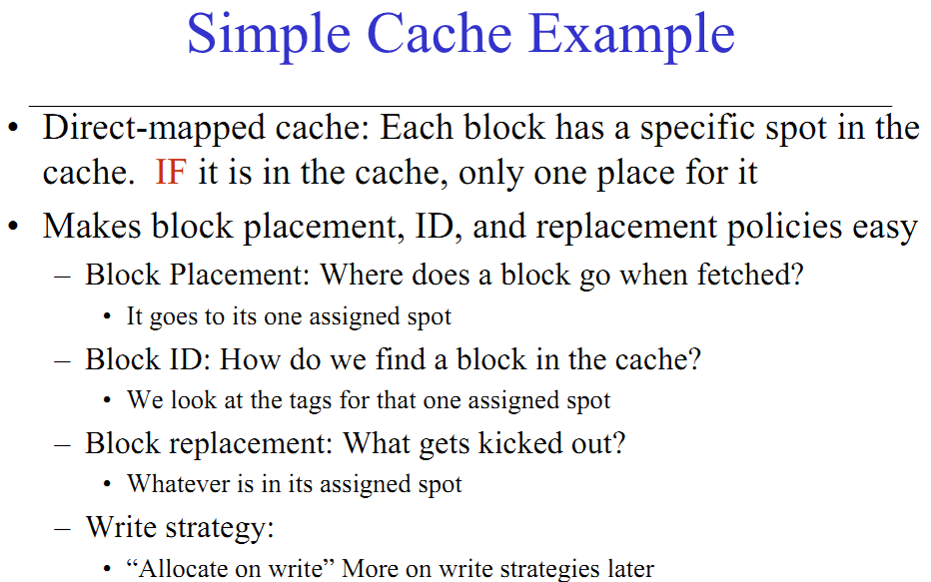
Caches

Slide 17
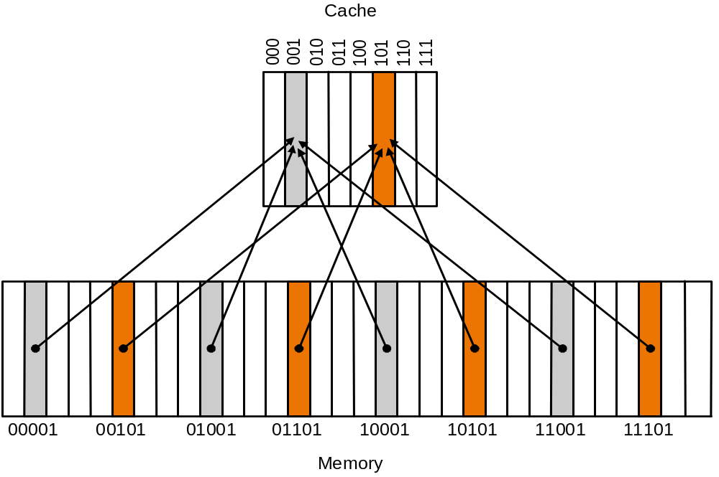
Direct Mapped Cache
Addressing scheme in direct mapped cache:
  cache block address = memory block address mod cache size (unique)
  if cache size = 2^{m}, cache address = lower m bits of n-bit memory address
  remaining upper n-m bits kept kept as tag bits at each cache block
  also need a valid bit to
  recognize valid entry

Slide 18
What happens on a memory access
The lowest k bits of the address will index a block in the cache
If the block is valid and the tag matches the upper (m - k) bits of the m-bit address, then that data will be sent to the CPU (cache hit)
Otherwise (cache miss), data is read from main memory and
  stored in the cache block specified by the lowest k bits of the address
  the upper (m - k) address bits are stored in the block’s tag field
  the valid bit is set to 1
If our CPU implementations accessed main memory directly, their cycle times would have to be much larger
  Instead we assume that most memory accesses will be cache hits, which allows us to use a shorter cycle time
On a cache miss, the simplest thing to do is to stall the pipeline until the data from main memory can be fetched and placed in cache.

Slide 19
Accessing Cache
Example:
(0) Initial state:
(1) Address referred 10110 (miss):
Index V Tag Data
000 N
001 N
010 N
011 N
100 N
101 N
110 N
111 N
Index V Tag Data
000 N
001 N
010 N
011 N
100 N
101 N
110 Y 10 Mem(10110)
111 N

Slide 20
(2) Address referred 11010 (miss):
(3) Address referred 10110 (hit):
Index V Tag Data
000 N
001 N
010 Y 11 Mem(11010)
011 N
100 N
101 N
110 Y 10 Mem(10110)
111 N
Index V Tag Data
000 N
001 N
010 Y 11 Mem(11010)
011 N
100 N
101 N
110 Y 10 Mem(10110)
111 N
to CPU
(4) Address referred 10010 (miss):
Index V Tag Data
000 N
001 N
010 Y 10 Mem(10010)
011 N
100 N
101 N
110 Y 10 Mem(10110)
111 N

Slide 21
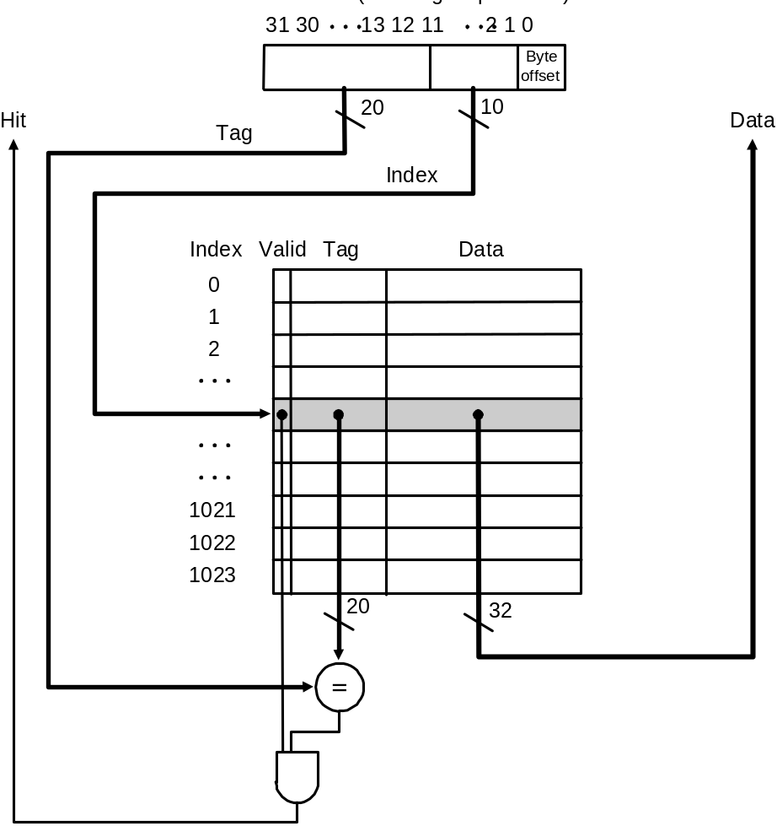
Direct Mapped Cache
Address showing bit positions
MIPS style:
What kind of locality are we taking advantage of?
Cache with 1024 1-word blocks: byte offset
(least 2 significant bits) is ignored and
next 10 bits used to index into cache

Slide 22
Average memory access time
The average memory access time, or AMAT, can then be computed
AMAT = Hit time + (Miss rate x Miss penalty)
This is just averaging the amount of time for cache hits and the amount of time for cache misses
How can we improve the average memory access time of a system?
  Obviously, a lower AMAT is better
  Miss penalties are usually much greater than hit times, so the best way to lower AMAT is to reduce the miss penalty or the miss rate
However, AMAT should only be used as a general guideline. Remember that execution time is still the best performance metric.

Slide 23
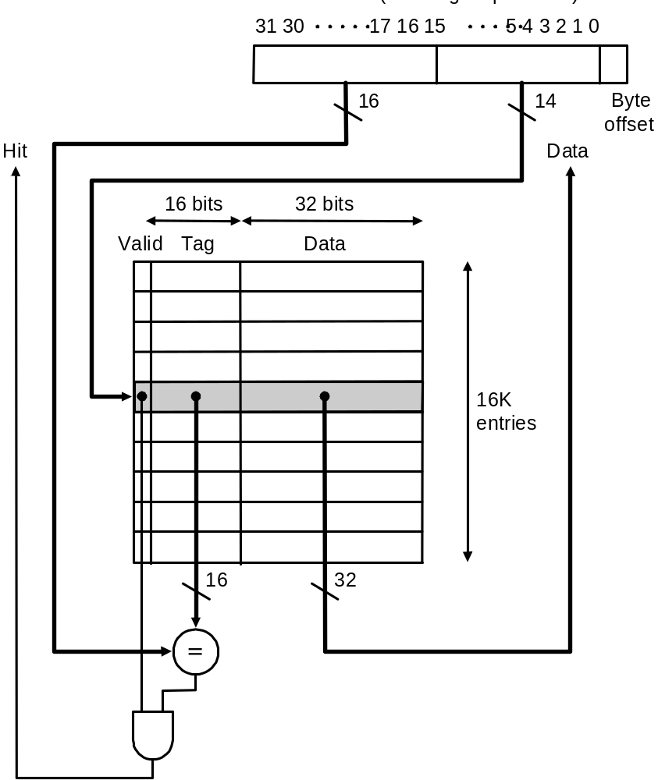
DECStation 3100 Cache
(MIPS R2000 processor)
Address showing bit positions
Cache with 16K 1-word blocks: byte offset
(least 2 significant bits) is ignored and
next 14 bits used to index into cache

Slide 24
Example Problem
How many total bits are required for a direct-mapped cache with 128 KB of data and 1-word block size, assuming a 32-bit address?
Cache data = 128 KB = 2¹⁷ bytes = 2¹⁵ words = 2¹⁵ blocks
Cache entry size = block data bits + tag bits + valid bit
= 32 + (32 – 15 – 2) + 1 = 48 bits
Therefore, cache size = 2¹⁵ × 48 bits = 2¹⁵ × (1.5 × 32) bits = 1.5 × 2²⁰ bits = 1.5 Mbits
  data bits in cache = 128 KB × 8 = 1 Mbits
  total cache size/actual cache data = 1.5

Slide 25
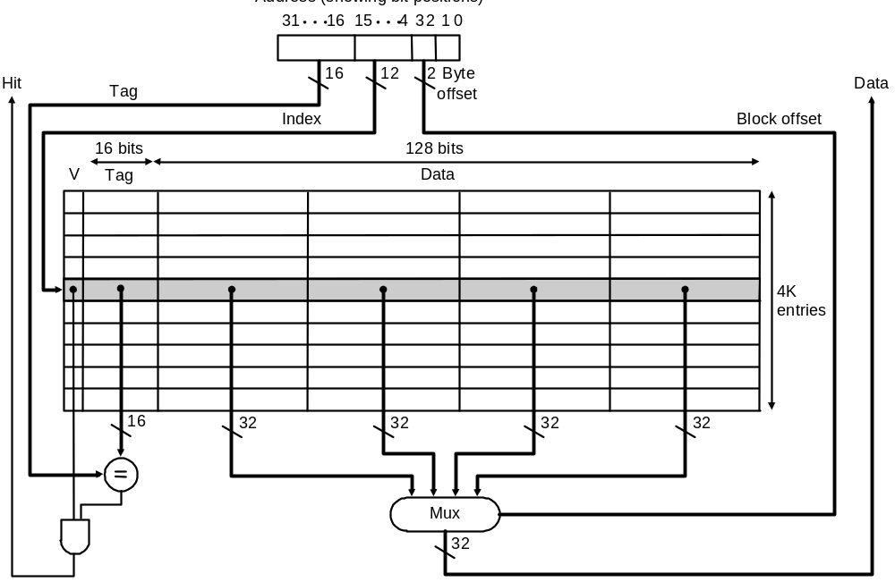
Direct Mapped Cache: Taking Advantage of Spatial Locality
Taking advantage of spatial locality with larger blocks:
Address showing bit positions
Cache with 4K 4-word blocks: byte offset (least 2 significant bits) is ignored, next 2 bits are block offset, and the next 12 bits are used to index into cache

Slide 26
Direct Mapped Cache: Taking Advantage of Spatial Locality
Cache replacement in large (multiword) blocks:
  word read miss: read entire block from main memory
  word write miss: cannot simply write word and tag! Why?!
  writing in a write-through cache:
    if write hit, i.e., tag of requested address and and cache entry are equal, continue as for 1-word blocks by replacing word and writing block to both cache and memory
    if write miss, i.e., tags are unequal, fetch block from memory, replace word that caused miss, and write block to both cache and memory
    therefore, unlike case of 1-word blocks, a write miss with a multiword block causes a memory read

Slide 27
Example Problem
How many total bits are required for a direct-mapped cache with 128 KB of data and 4-word block size, assuming a 32-bit address?
Cache size = 128 KB = 2¹⁷ bytes = 2¹⁵ words = 2¹³ blocks
Cache entry size = block data bits + tag bits + valid bit
= 128 + (32 – 13 – 2 – 2) + 1 = 144 bits
Therefore, cache size = 2¹³ × 144 bits = 2¹³ × (1.25 × 128) bits = 1.25 × 2²⁰ bits = 1.25 Mbits
  data bits in cache = 128 KB × 8 = 1 Mbits
  total cache size/actual cache data = 1.25

Slide 28
Performance
Simplified model assuming equal read and write miss penalties:
  CPU time = (execution cycles + memory stall cycles) × cycle time
  memory stall cycles = memory accesses × miss rate × miss penalty
Therefore, two ways to improve performance in cache:
  decrease miss rate
  decrease miss penalty

Slide 29
Example Problems
Assume for a given machine and program:
  instruction cache miss rate 2%
  data cache miss rate 4%
  miss penalty always 40 cycles
  CPI of 2 without memory stalls
  frequency of load/stores 36% of instructions
How much faster is a machine with a perfect cache that never misses?

Slide 30
Solution
1.
Assume instruction count = I
Instruction miss cycles = I × 2% × 40 = 0.8 × I
Data miss cycles = I × 36% × 4% × 40 = 0.576 × I
So, total memory-stall cycles = 0.8 × I + 0.576 × I = 1.376 × I
  in other words, 1.376 stall cycles per instruction
Therefore, CPI with memory stalls = 2 + 1.376 = 3.376
Assuming instruction count and clock rate remain same for a perfect cache and a cache that misses:
CPU time with stalls / CPU time with perfect cache
= 3.376 / 2 = 1.688
Performance with a perfect cache is better by a factor of 1.688

Slide 31
Decreasing Miss Rates with Associative Block Placment
Direct mapped: one unique cache location for each memory block
  cache block address = memory block address mod cache size
Fully associative: each memory block can locate anywhere in cache
  all cache entries are searched (in parallel) to locate block
Set associative: each memory block can place in a unique set of cache locations – if the set is of size n it is n-way set-associative
  cache set address = memory block address mod number of sets in cache
  all cache entries in the corresponding set are searched (in parallel) to locate block
Increasing degree of associativity
  reduces miss rate
  increases hit time because of the parallel search and then fetch

Slide 32
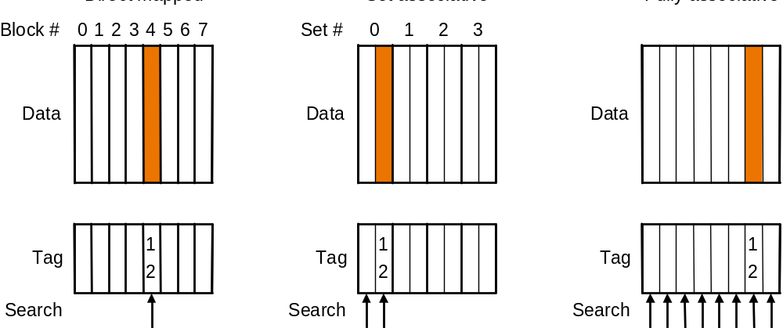
Decreasing Miss Rates with Associative Block Placment
Direct Mapped
2-way Set Associative
Fully Associative
12 mod 8 = 4
12 mod 4 = 0
Location of a memory block with address 12 in a cache with 8 blocks
with different degrees of associativity

Slide 33
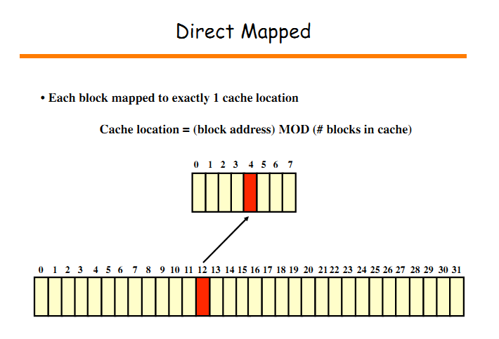


Slide 34
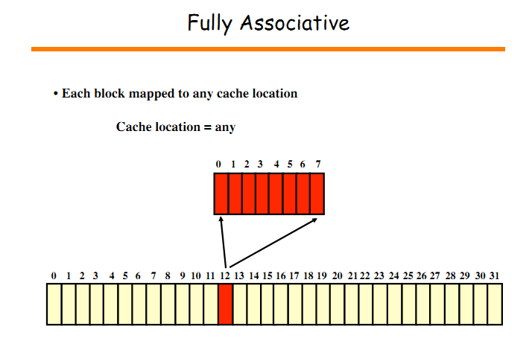

Slide 35
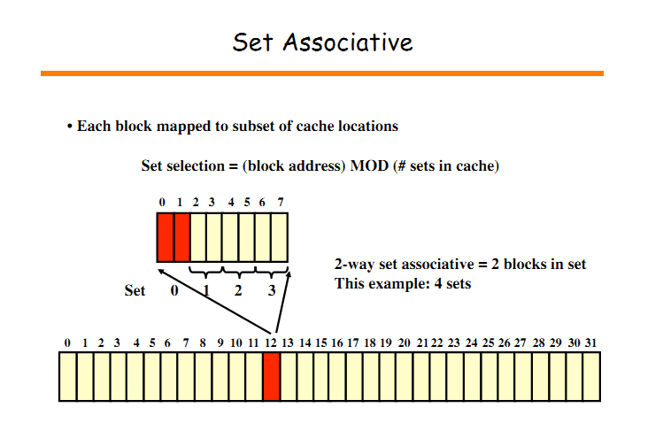

Slide 36
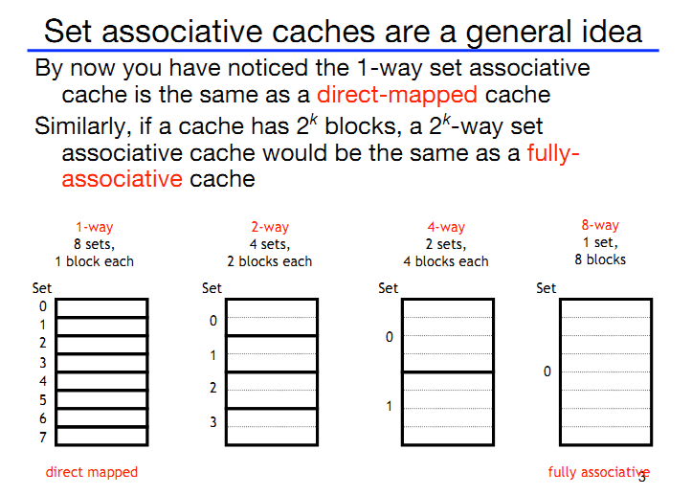

Slide 37
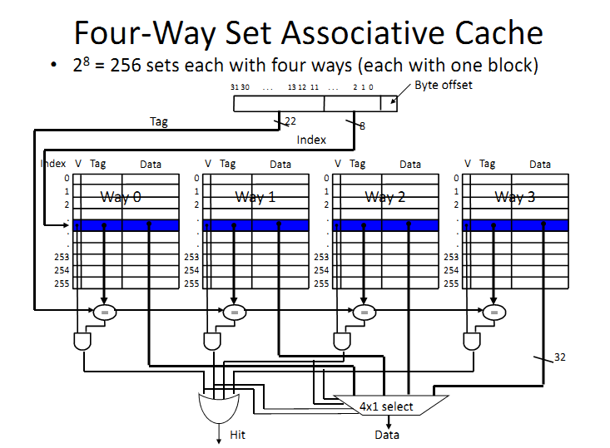

Slide 38
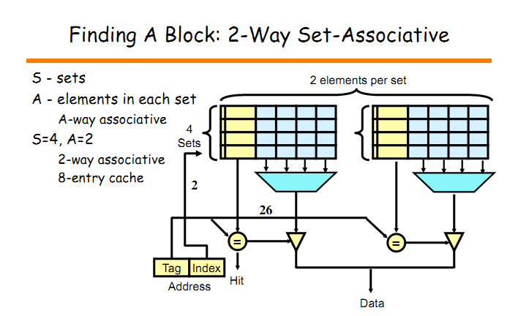

Slide 39
